Slide 1

I’ve been doing some syncing…
Paul Lammertsma
CTO, Pixplicity

Slide 2
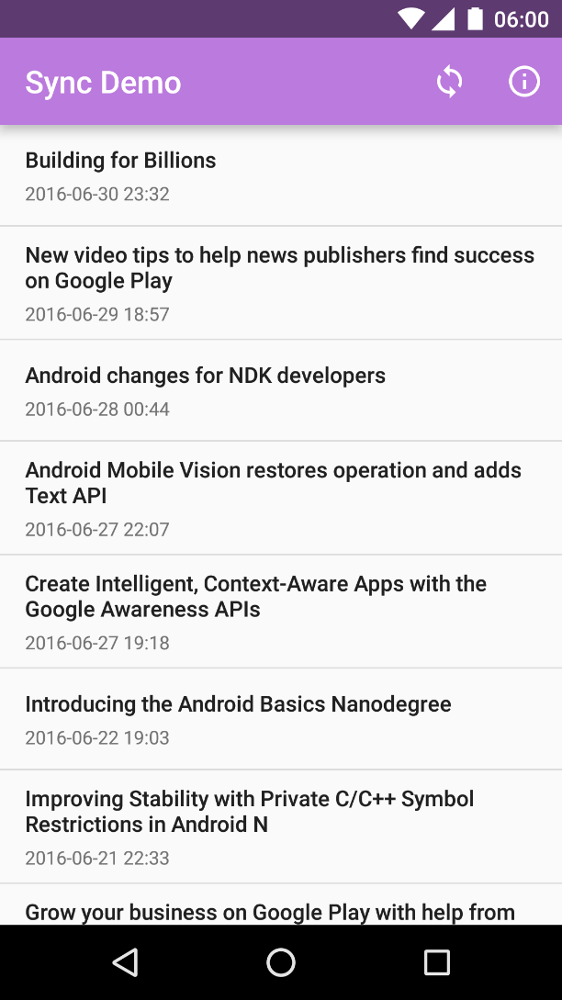
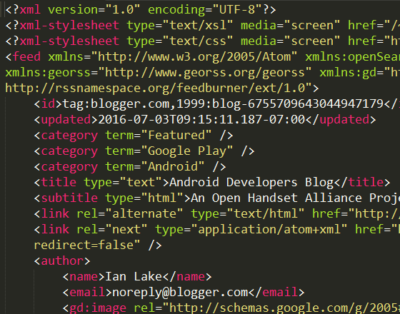
UI
Network
ze internet

Slide 3
UI
ContentResolver.query()
ContentProvider
ContentResolver.insert()
Network
ze internet

Slide 4
CursorLoader
UI
ContentObserver
ContentResolver.query()
ContentProvider
ContentResolver.insert()
Network
ze internet

Slide 5
CursorLoader
UI
ContentObserver
ContentResolver.query()
ContentProvider
ContentResolver.insert()
SyncAdapter
Network
Android Framework
ze internet
Hey, this would be a great moment to synchronize!

Slide 6
https://github.com/googlesamples/android-BasicSyncAdapter
https://developer.android.com/training/sync-adapters/creating-sync-adapter.html
https://developer.android.com/training/sync-adapters/index.html
http://blog.udinic.com/2013/07/24/write-your-own-android-sync-adapter/
https://software.intel.com/en-us/android/articles/handling-offline-capability-and-data-sync-in-an-android-app-part-2

Slide 7
SyncAdapters can be used to:
fetch background data for an app.
execute your data transfer code at configurable intervals, while efficiently using battery and other system resources
Elements of a sync adapter:
Creates a sync adapter class.
Creates a bound Service which the OS uses to initiate a sync.
Defines the sync adapter properties in an XML resource file.
Declares the bound Service in the app manifest.

Slide 8
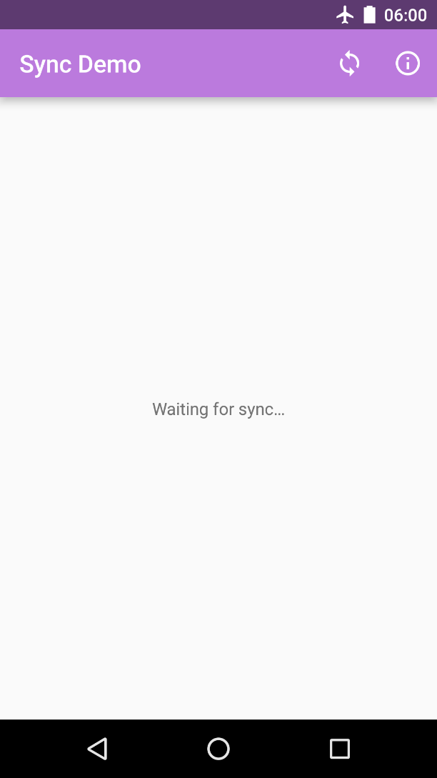
Demo

Slide 9
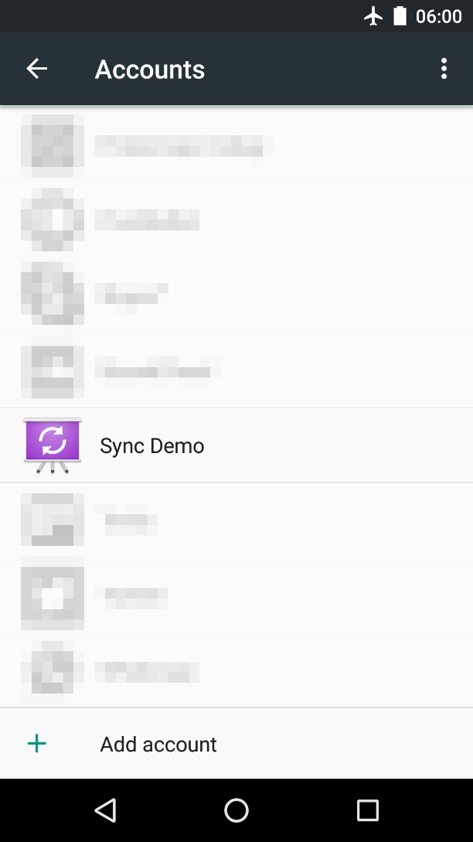
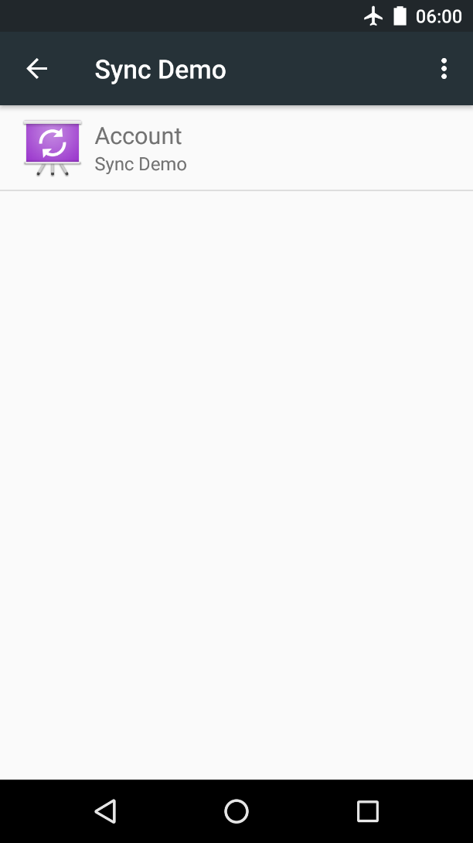
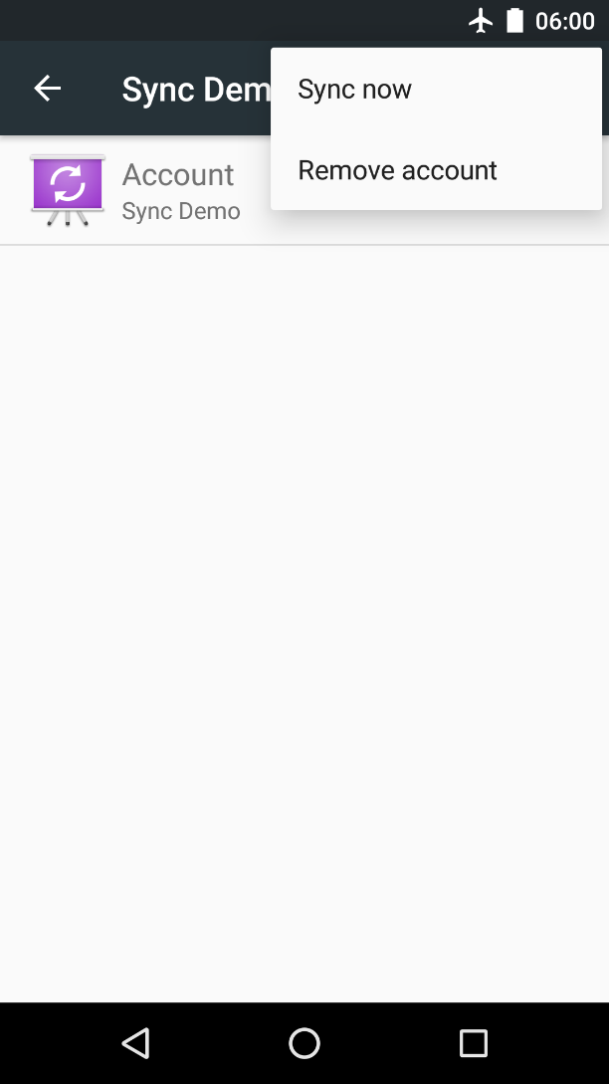
Demo

Slide 10
Extend the base sync adapter class AbstractThreadedSyncAdapter
/** * Handle the transfer of data between a server and an * app, using the Android sync adapter framework. */ public class SyncAdapter extends AbstractThreadedSyncAdapter {
/** * Set up the sync adapter */ public SyncAdapter(Context context, boolean autoInitialize) {
super(context, autoInitialize);
}
public SyncAdapter( Context context, boolean autoInitialize, boolean allowParallelSyncs) { super(context, autoInitialize, allowParallelSyncs);
}
}

Slide 11
onPerformSync()
Sync adapter framework invokes your SyncAdapter
Calls onPerformSync()
Account
Bundle
Authority
ContentProviderClient
SyncResult

Slide 12
onPerformSync()
/* * Specify the code you want to run in the sync adapter. The entire * sync adapter runs in a background thread, so you don't have to set * up your own background processing. */ @Override public void onPerformSync( Account account, Bundle extras, String authority, ContentProviderClient provider, SyncResult syncResult) { /* * Put the data transfer code here. */ ... }

Slide 13
Beginner’s Workshop
Paul Lammertsma
CTO, Pixplicity

